Slide 1
HOW TO UPDATE ROTARACT CLUB & MEMBER DATA
Pictured: Members of the Noale dei Tempesta Rotaract Club in Italy

Slide 2
Rotaract clubs are required to update their club and member data every six months.
Not updating puts your club at risk of termination.

Slide 3
Also, when you update your information, you make it easier to get connected to other clubs using the Worldwide Rotaract Directory.

Slide 4
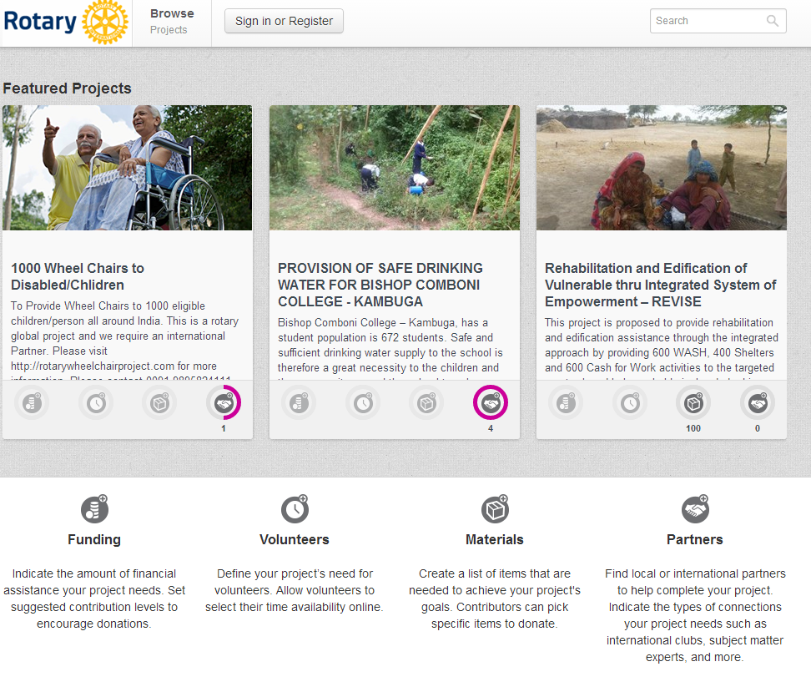
Active Rotaract clubs can also use tools on Rotary’s website like ideas.rotary.org, which helps you find funding or volunteers for a project

Slide 5
Active clubs can share success stories on Rotary Showcase (www.rotary.org/showcase)

Slide 6
Active clubs can contribute to discussion groups on Rotary’s website

Slide 7
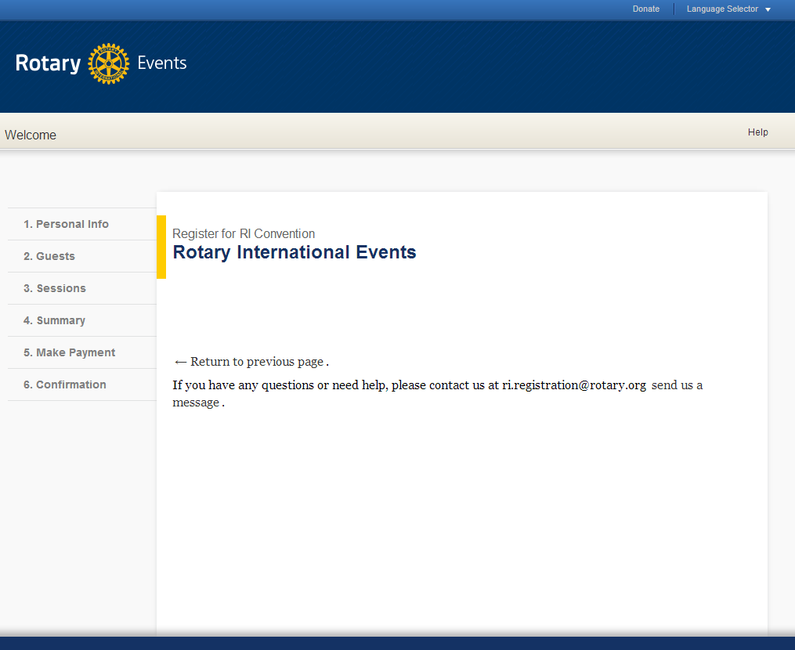
And all reported Rotaractors can register online for the Rotary International Convention

Slide 8
We’ll show you how to update your Rotaract club’s information so you have access to all these resources.

Slide 9
Please note that only current and reported Rotaract club presidents and Rotaract advisers will be given behind the scenes access to update club and member data.

Slide 10
Get started at www.rotary.org

Slide 11
Click on My Rotary

Slide 12
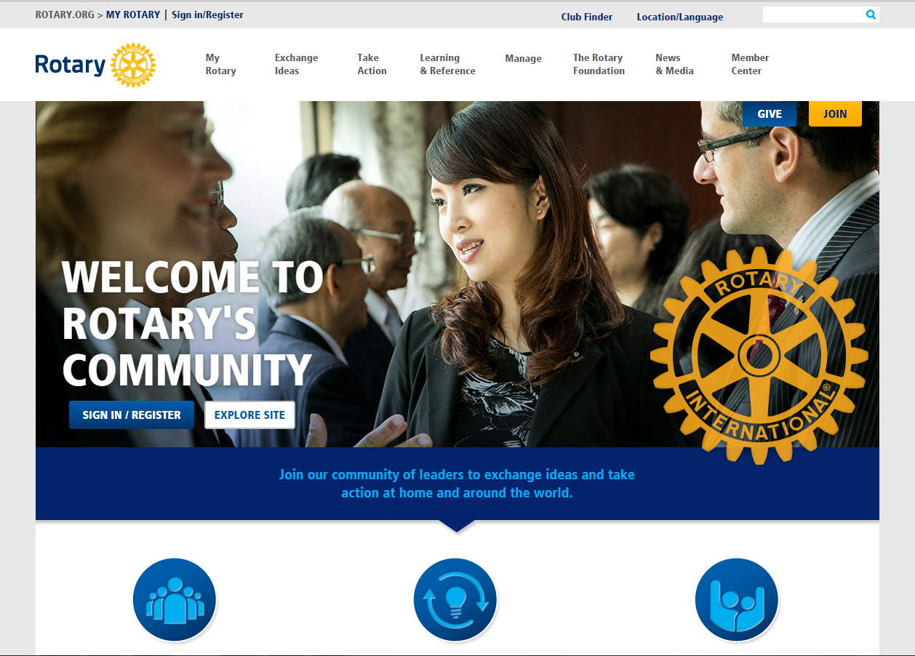
Click Sign In/Register

Slide 13
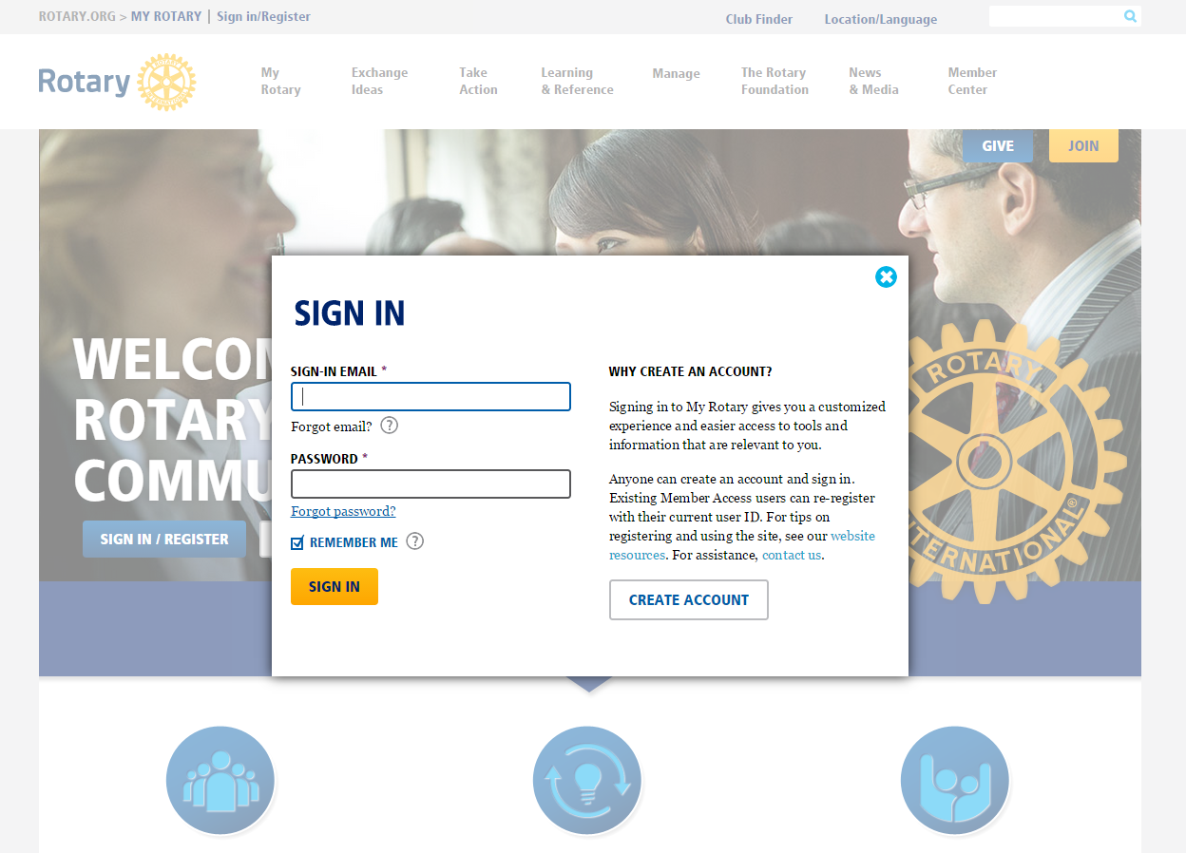
Then sign in to your account

Slide 14
If you don’t have an account, click create account

Slide 15
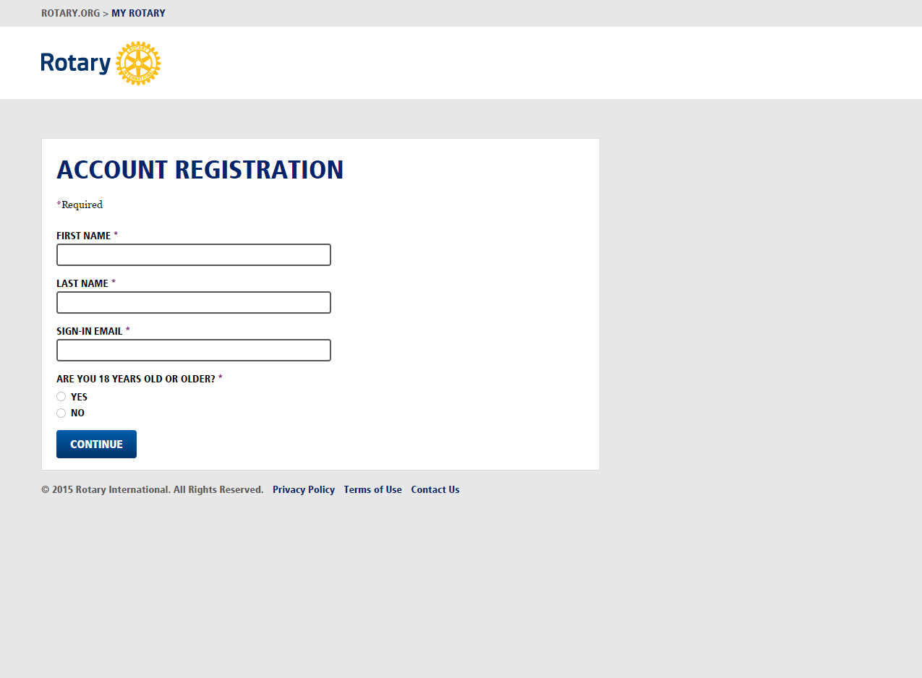
TROUBLESHOOTING: When you create an account, you must use the same email address that was reported to Rotary International for your role

Slide 16
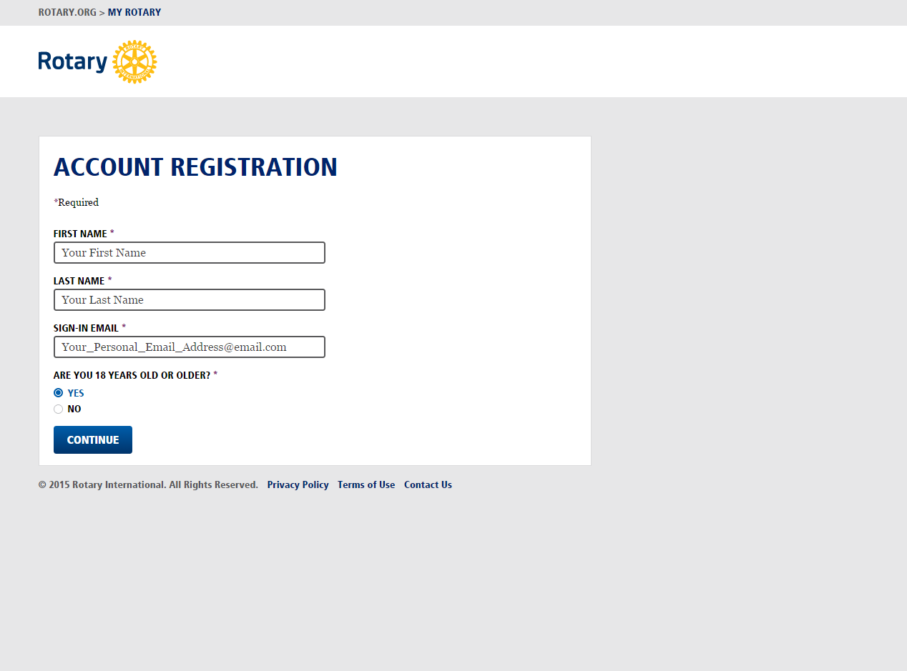
Note: Please use your personal email and not a shared email. This is YOUR My Rotary account

Slide 17
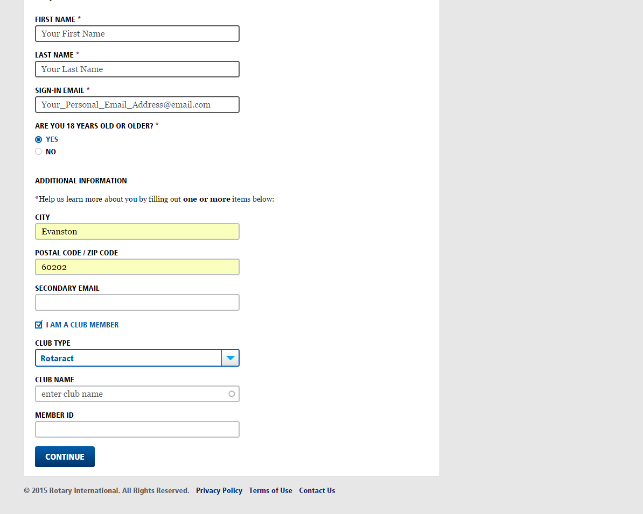
Enter your City and Postal Code. Then select “I am a club Member” and choose “Rotaract” as the club type

Slide 18
Begin typing the name of your club and choose the correct entry from the dropdown menu
Please note your club name will appear as it is recorded in the Rotary International database, not as the club is referred to locally. If you cannot correctly identify your club from the dropdown menu, contact rotaract@rotary.org, check your club/district records, or confirm the club name on your official Certificate of Organization provided by Rotary.

Slide 19
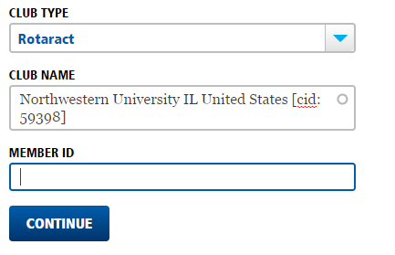
If you know your Member ID enter it, if not you can leave the field blank. When finished click Continue
Notes:
Please note to select the Rotaract club name as it appears on Rotary International database, not as the club is referred to locally. If you do not know this information, you can contact rotaract@rotary.org, or look into your club/district records to see the name on your Certificate of Organization provided by RI.

Slide 20
NOTE: Please wait 72 hours for new accounts to be created. Then you can return to the sign in screen at Rotary.org.

Slide 21
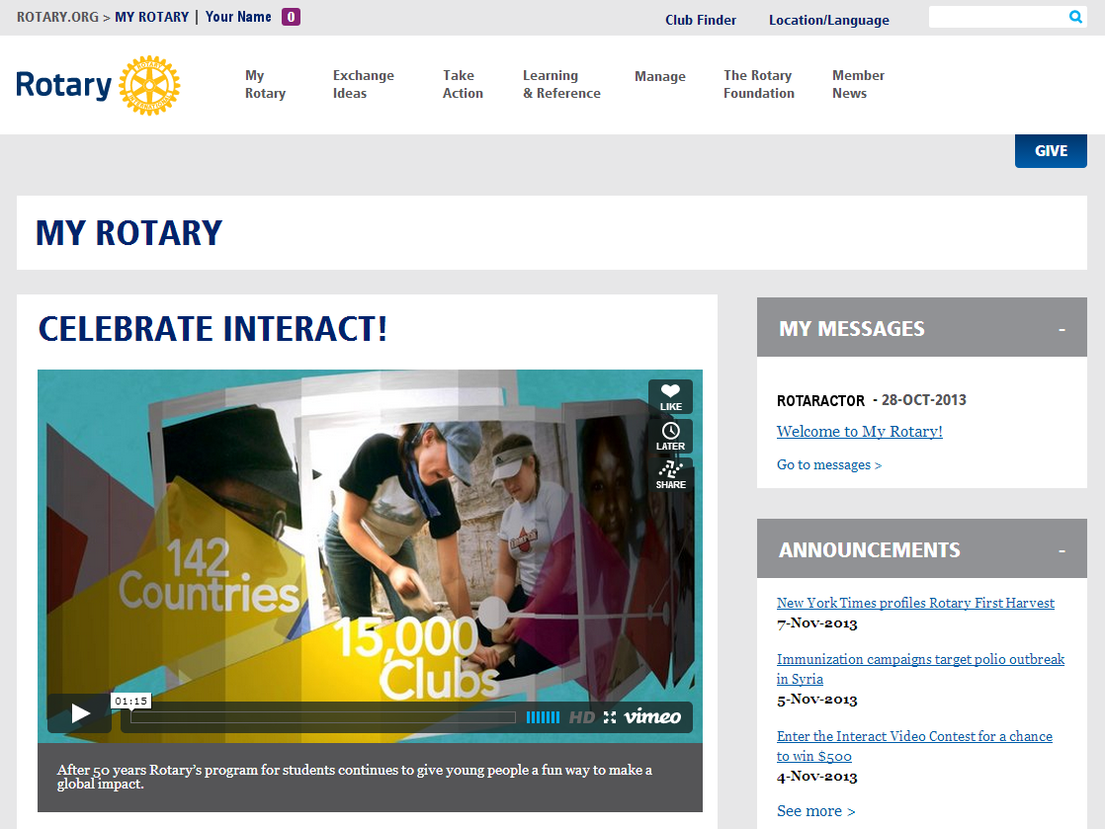
After you sign in, you’ll see your My Rotary homepage

Slide 22
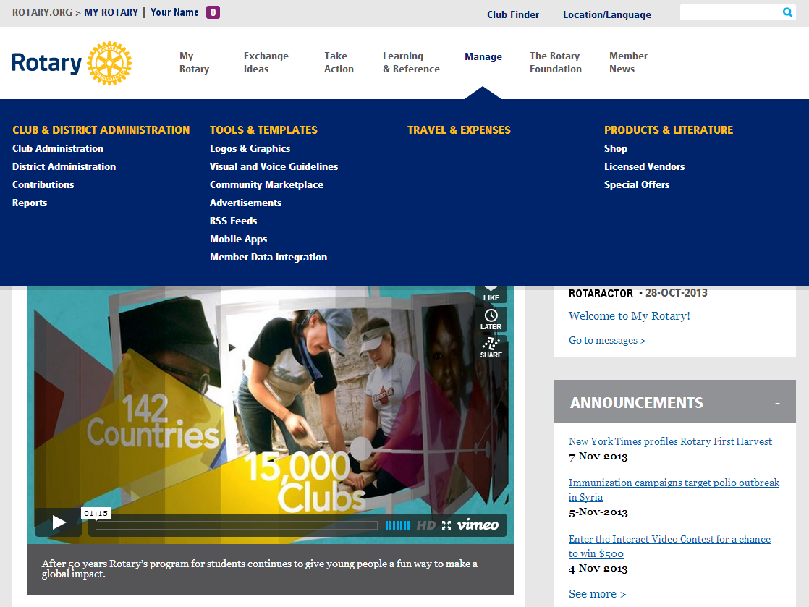
Hover over Manage, then click Club Administration

Slide 23
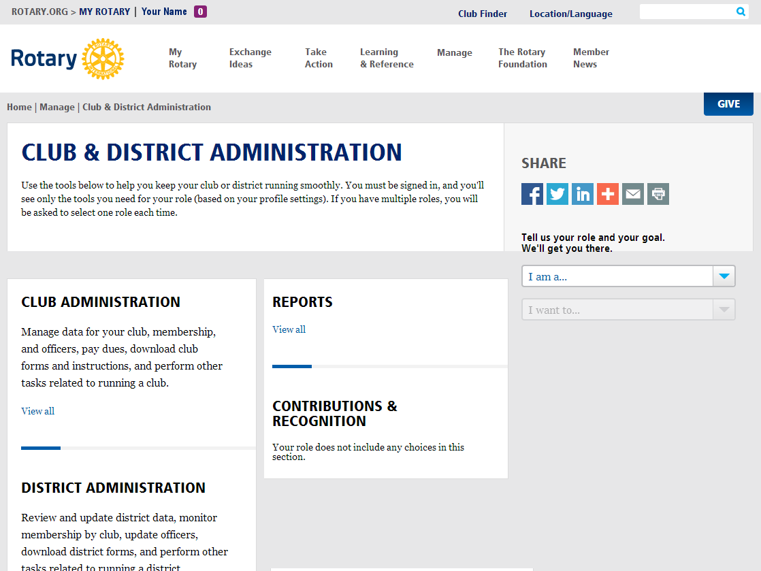
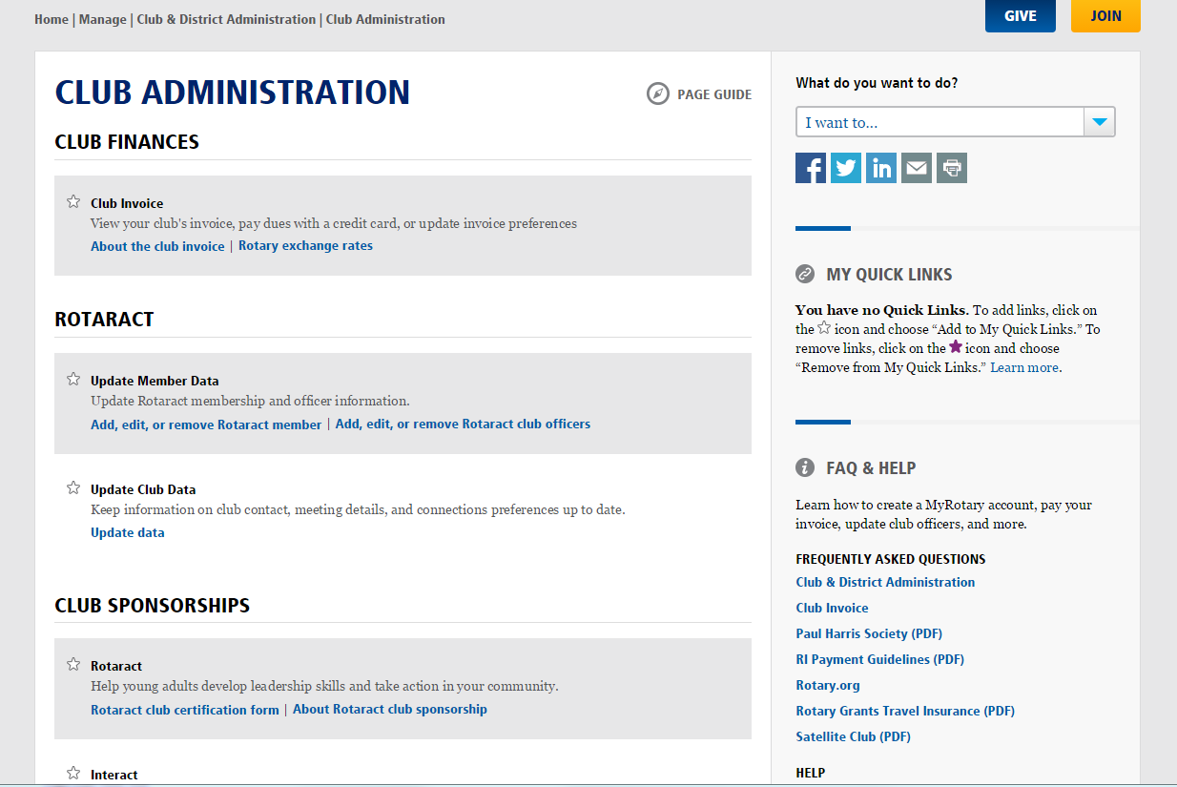
Click Add, edit, or remove Rotaract member to access your club administration page

Slide 24
NOTE: If the Add, edit, or remove Rotaract member link does not appear, your sign-in email address is not connect to your role as Rotaract president or adviser.

Slide 25
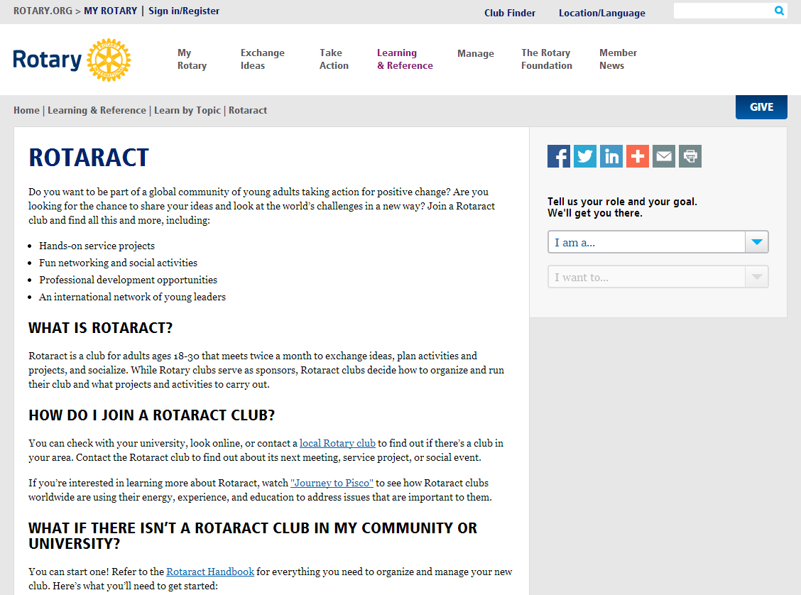
Haven’t reported a Rotaract club president or Rotaract adviser for your club? Start by going to www.rotary.org/rotaract

Slide 26
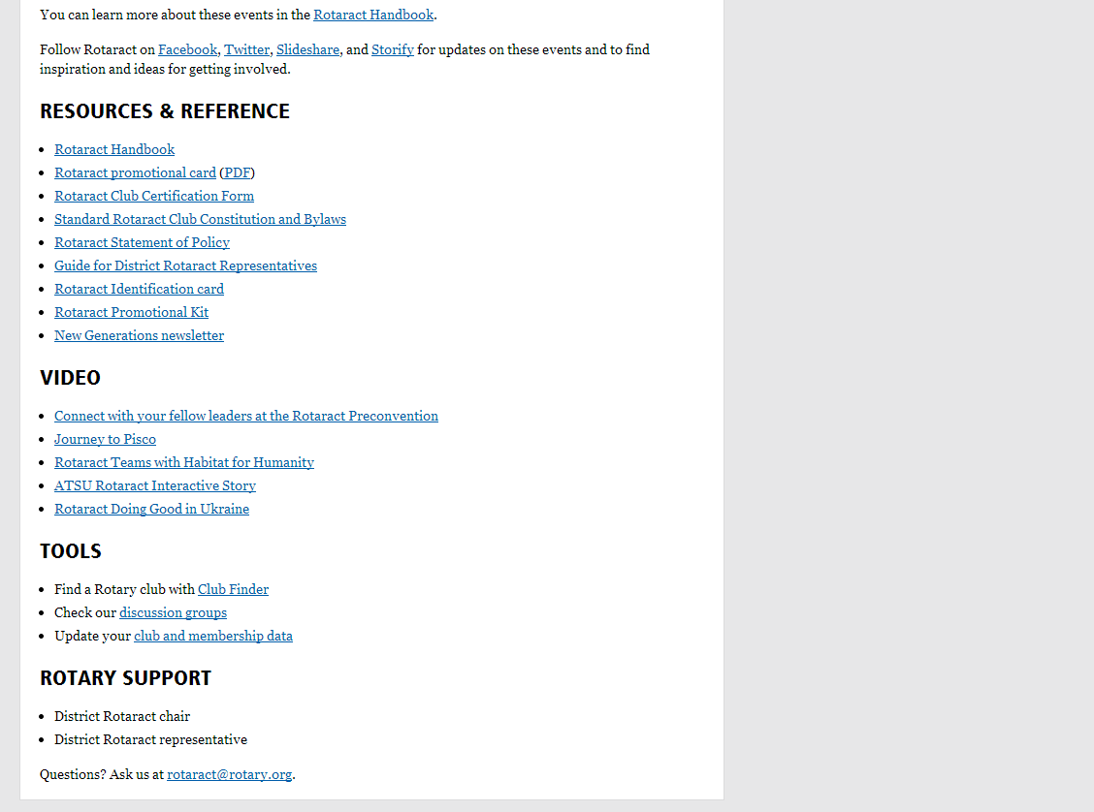
Scroll down to Tools, then click Update your club and membership data

Slide 27
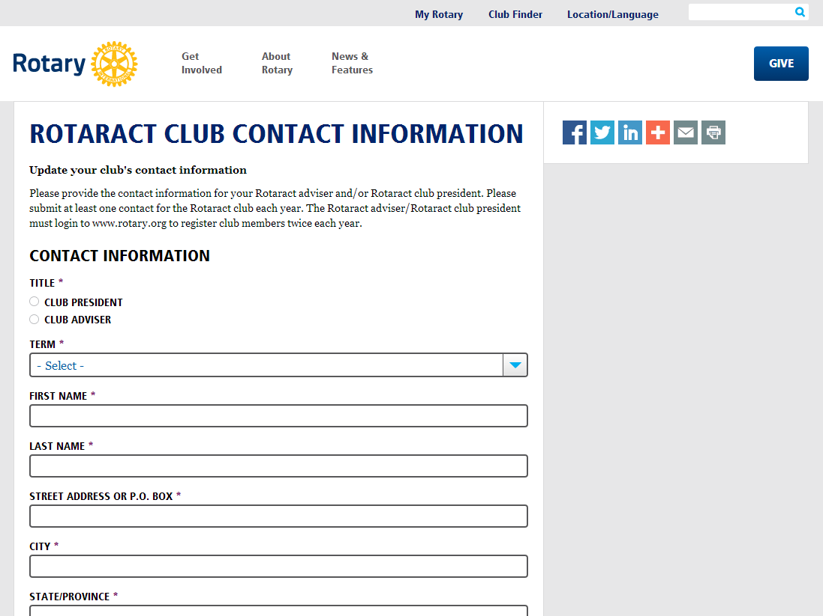
Complete this form to report the Rotaract president or Rotaract adviser for the current Rotary year

Slide 28
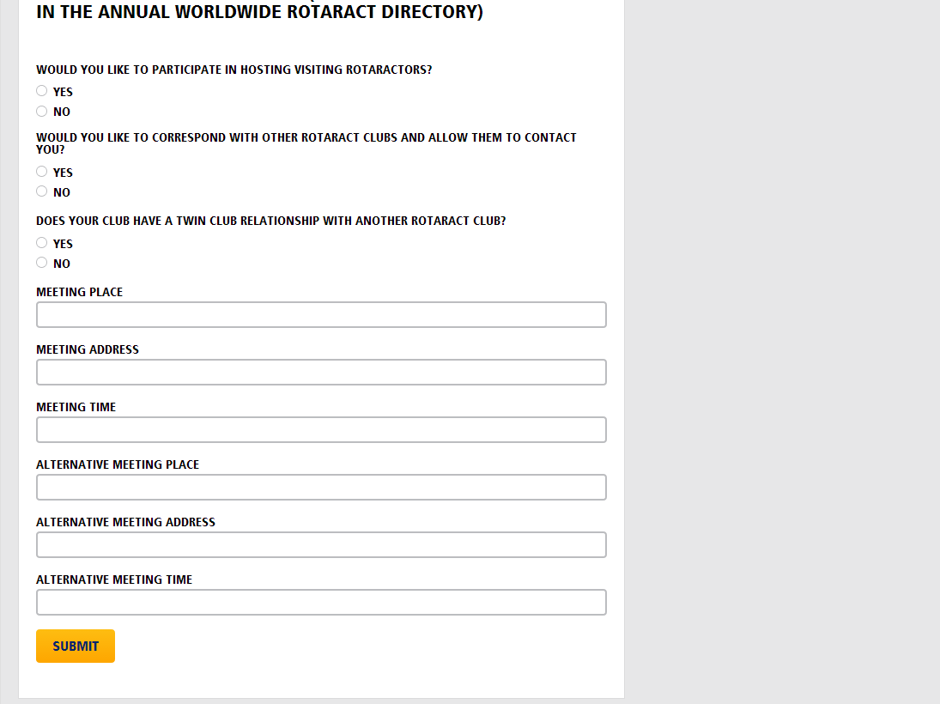
After the form is submitted, the data will be entered into Rotary’s database within 72-96 hours. Then you can sign in with the proper access

Slide 29
If your email address has been reported but you don’t see the Rotaract section, clear your browser’s cache then try signing out of Rotary.org and signing back in again.

Slide 30
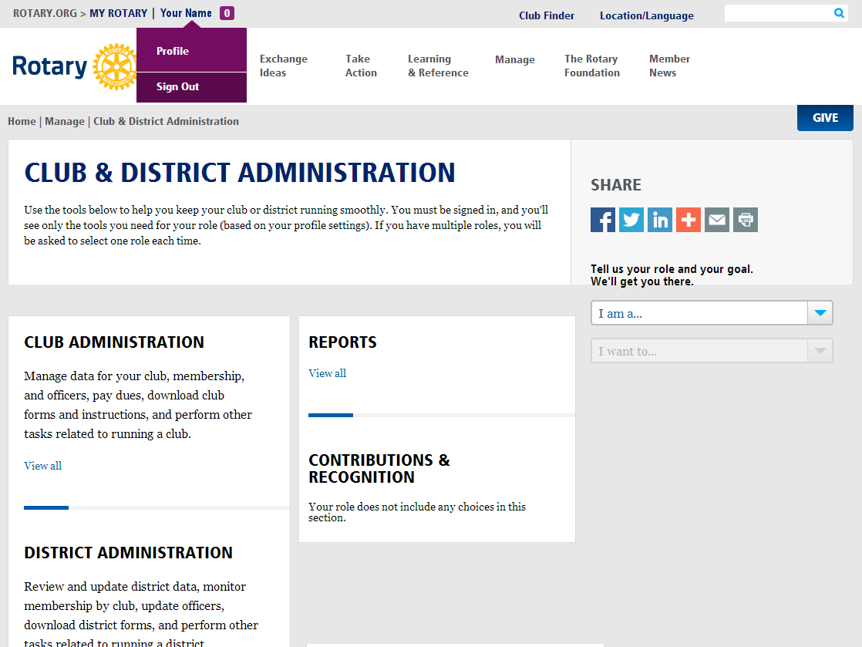
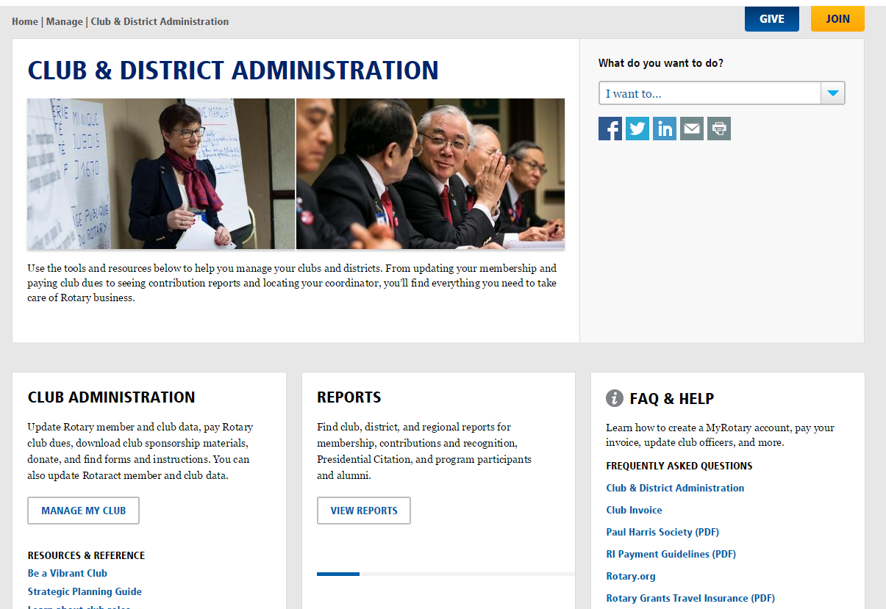
You can sign out by hovering over your name at the top of the My Rotary site. Click Sign Out, then Sign In again

Slide 31
Once you receive the proper access, click on Add, edit, or remove Rotaract member

Slide 32
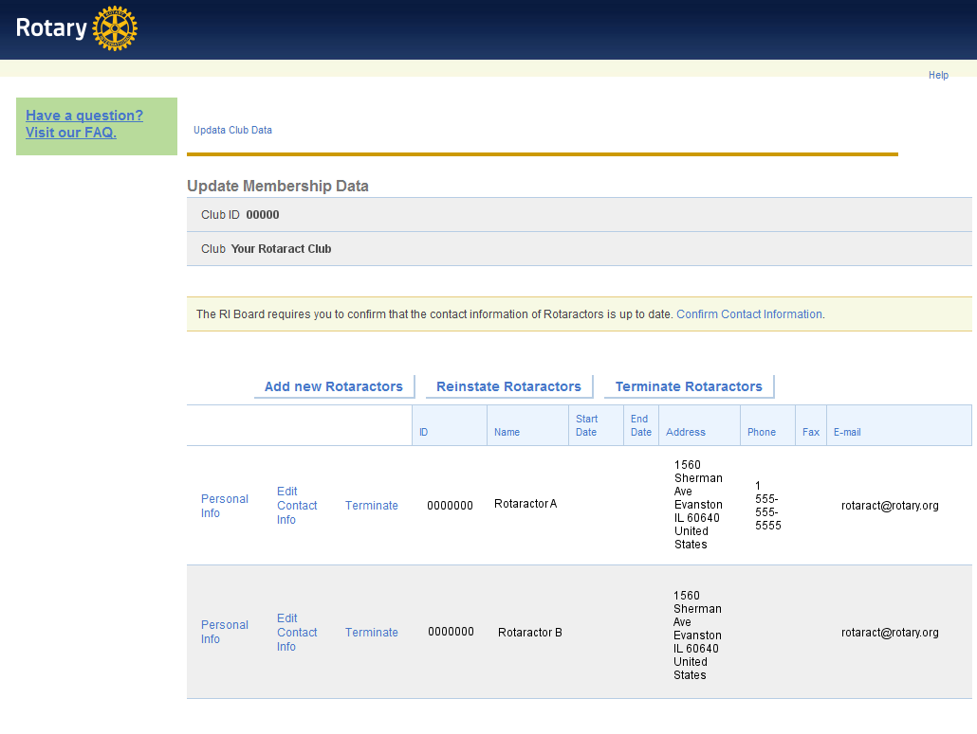
Here is where you can update member data

Slide 33
Make sure all the members of your Rotaract club appear. If any are missing, you can add them

Slide 34
If you see individuals who are no longer in your Rotaract club, you can remove them

Slide 35
NOTE: If as a reported club president/advisor you face any challenges adding members, it may be because those members already have a My Rotary profile. If they do, and they’re not connected with a Rotaract club, those individuals should email data@rotary.org to get connected with their club. They should provide their name, email address with which they created the My Rotary account, the name of the Rotaract club and the sponsor Rotary club.
Notes:
ADD A SLIDE: If as a reported club president/advisor you face any challenges adding members, it may be because those members already have a My Rotary profile. If they do, and they’re not connected with a Rotaract club, those individuals should email data@rotary.org to get connected with your club. They should provide their name, email address with which they created the My Rotary account, the name of the Rotaract club and the sponsor Rotary club.

Slide 36
NOTE: Rotaractors can also report themselves as members when they create a My Rotary account. Just make sure they select your Rotaract club during the registration process.
Each member, regardless of role, must have their own email address when creating their My Rotary account.

Slide 37
Approximately 72 hours after new accounts are created the Rotaract Club president can then return to the Club Administration page to verify that new members appear in their club membership data.

Slide 38
Once all new members have been added, click Confirm Contact Information

Slide 39
Now click Update Club Data

Slide 40
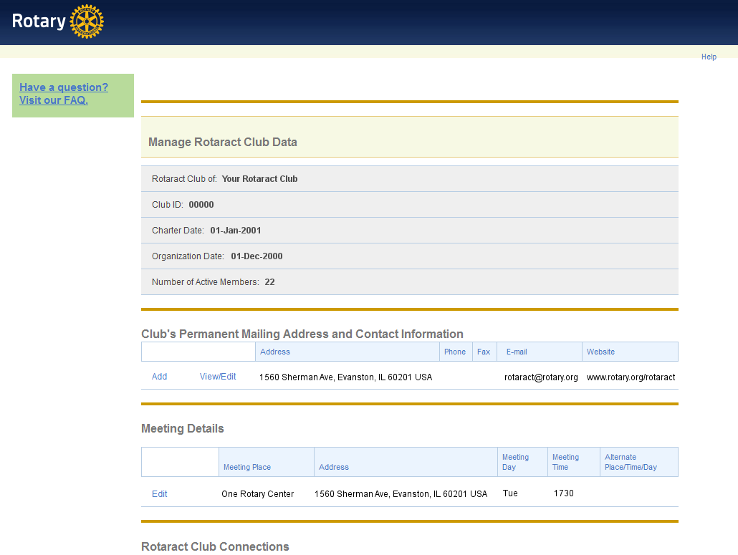
Here you can update your Rotaract club’s president, mailing address, website, and meeting time

Slide 41
Make sure your meeting information includes a complete street address with postal code. These details will appear in the Worldwide Rotaract Directory

Slide 42
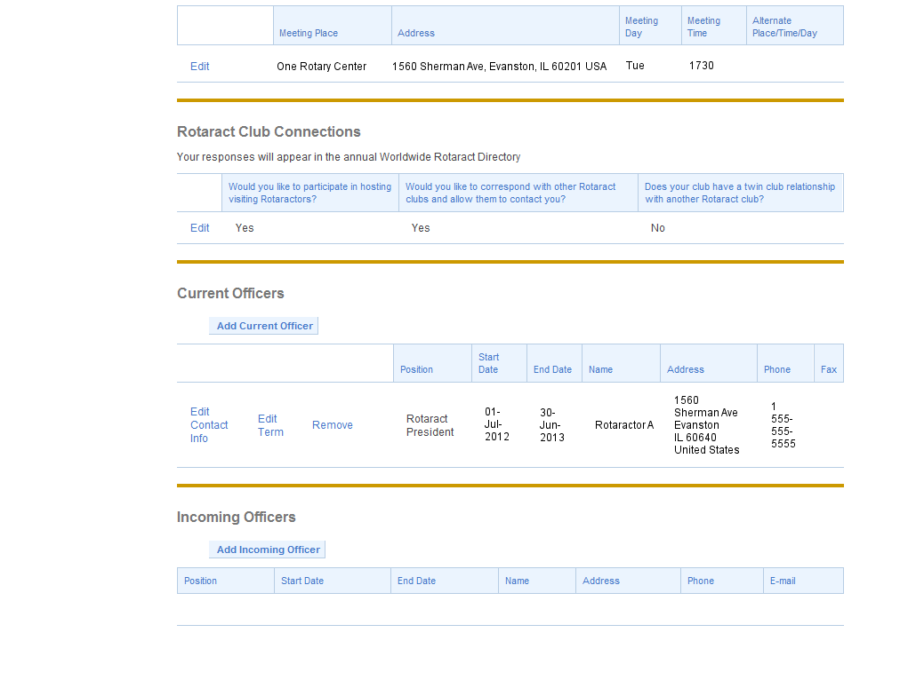
Add the president-elect for your club so they can easily continue this process next year. They will need their own My Rotary account

Slide 43
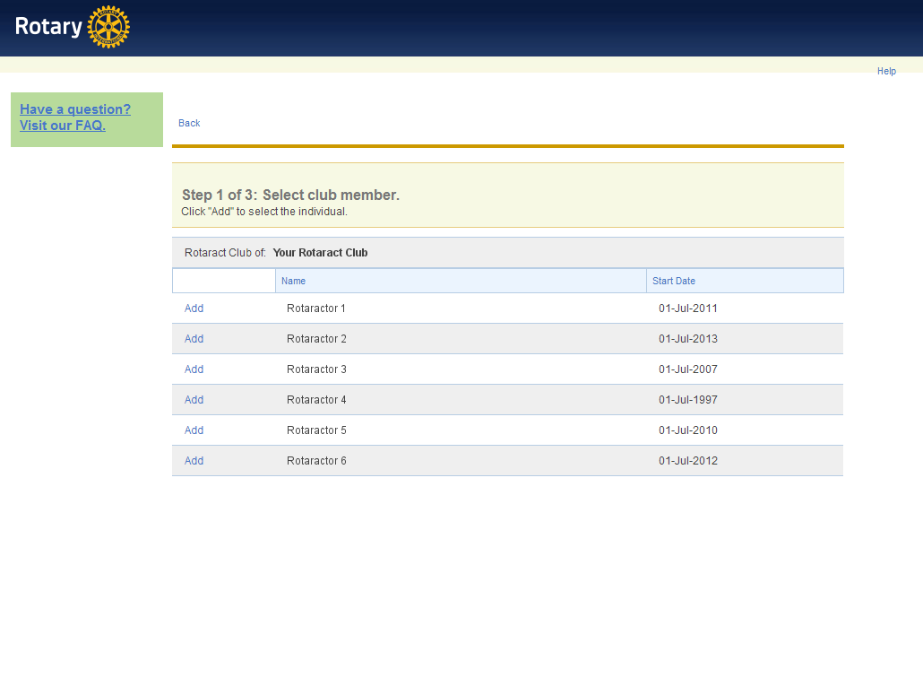
Click Add next to a member’s name to add them as president-elect. NOTE: A person must be reported as a club member to be added as president-elect

Slide 44
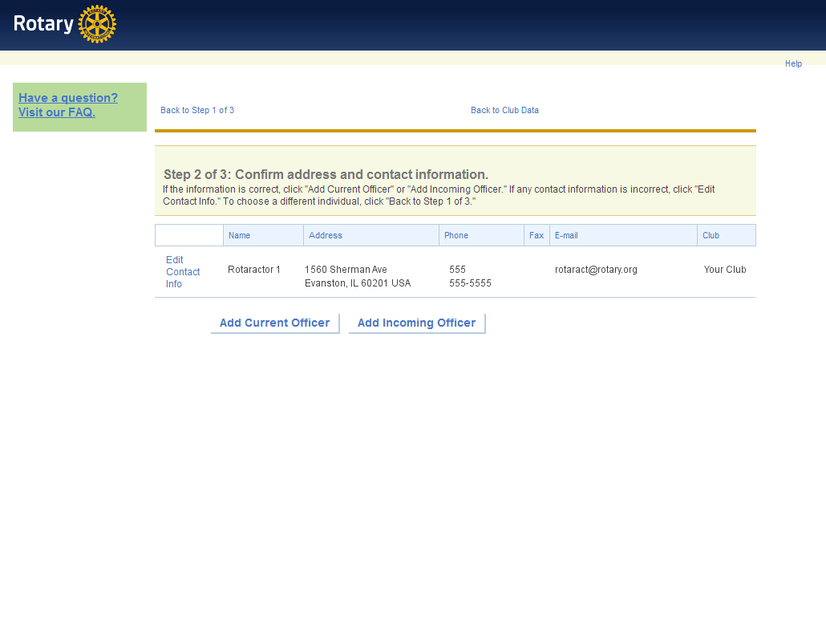
Confirm the person’s contact information, then select Add Incoming Officer

Slide 45
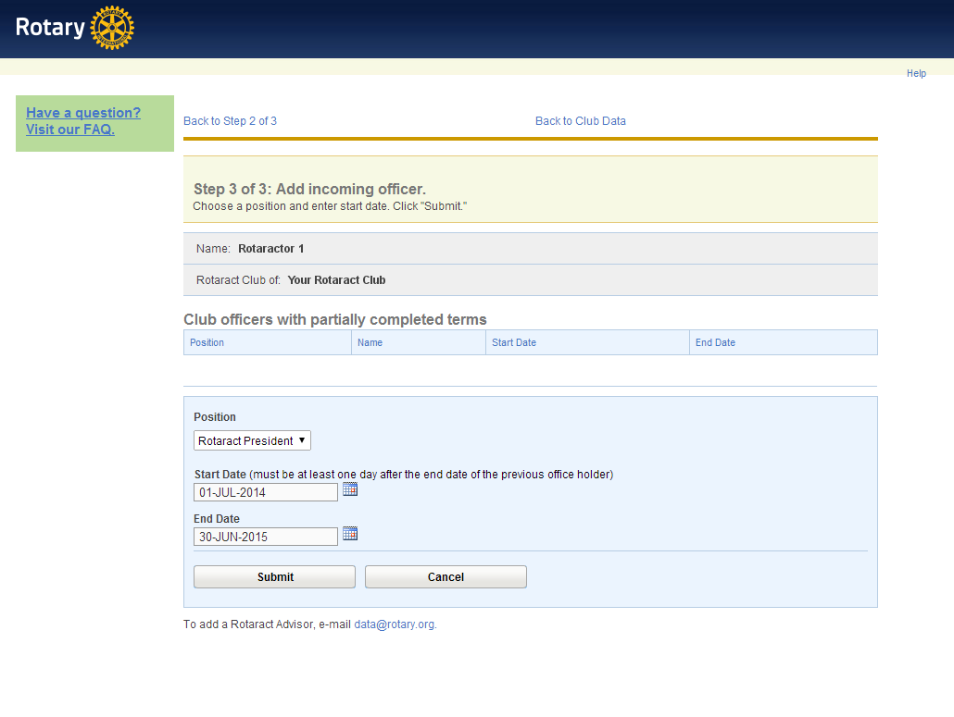
Select the correct term, then click Submit. NOTE: Currently the only officer position you can report on this form is Rotaract President

Slide 46
Be sure to update your club’s information twice each year, by 30 September and 31 March.
Thanks for keeping your club connected to the global network of Rotaract!

Slide 47
Questions?
Email us at rotaract@rotary.org

